Slide 1
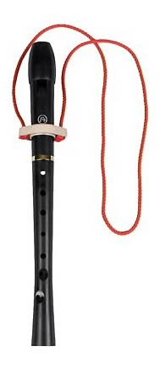
RECORDER PROCEDURES
When you come into the music room,
find your class drawer and take your recorder out.
Sit down in your assigned seat and put your recorder together (only 1 hole in the back and all parts together tightly.)
Do not blow air through the recorder until told to do so. If you do, I will say “Off with your head!” which means you need to take the top piece off of your recorder and wait until I tell you to put it back together.
NEVER play your recorder in the halls, while waiting for carpool, or while riding on the bus!

Slide 2
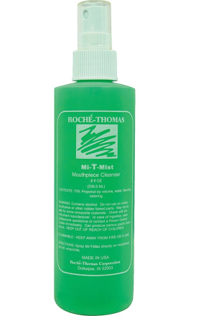
If you forget your recorder at home
Take a recorder from the “School Recorders” box
When we are done with class, spray the
mouthpiece from a couple of inches away so
the mist covers the area in or near your mouth
Place the recorder gently in the “Used Today” box
Mistakes are a part of learning. If you need to use a school recorder more than twice, you are not learning, you are in the habit of being irresponsible and you need to make a new habit!

Slide 3
COMMON QUESTIONS AND ANSWERS
Q. How do I put my recorder together?
A. “Whistle” on top; line up the holes (only the thumb hole is in the back); if you have a “foot,” position the bottom holes a little to the right of the others so that your pinky can reach the bottom.
Q. How do I put my neck strap on?
A. Take the whistle off, put the bottom through the ring (knots on the bottom, “Halo Hanger” on the top), put the pieces back together, with all of the holes lined up.
Q. What songs are we going to play? Can we play other songs? What if I already know how to play the recorder?
A. We will play lots of songs, please be patient and you will find out which songs we will play! If you have already learned to play recorder, it will not be as difficult for you this time and you can be a good example for others who are learning for the first time.
Q. How/When do I clean it? How do I use the stick or grease?
A. See the next 4 slides!

Slide 4
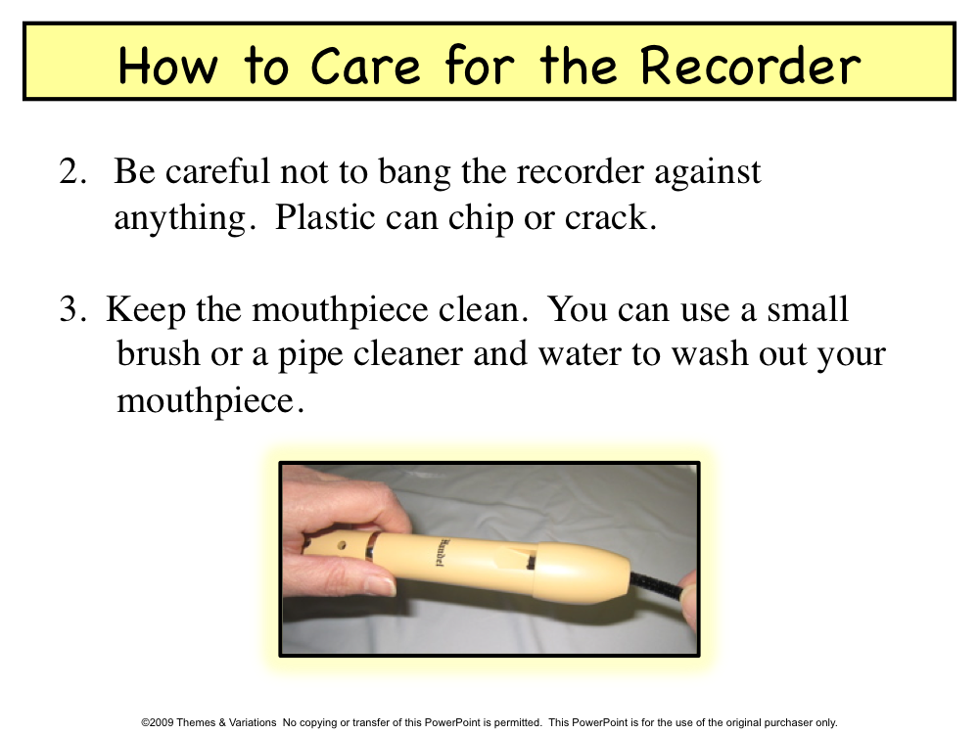
Index

Slide 5
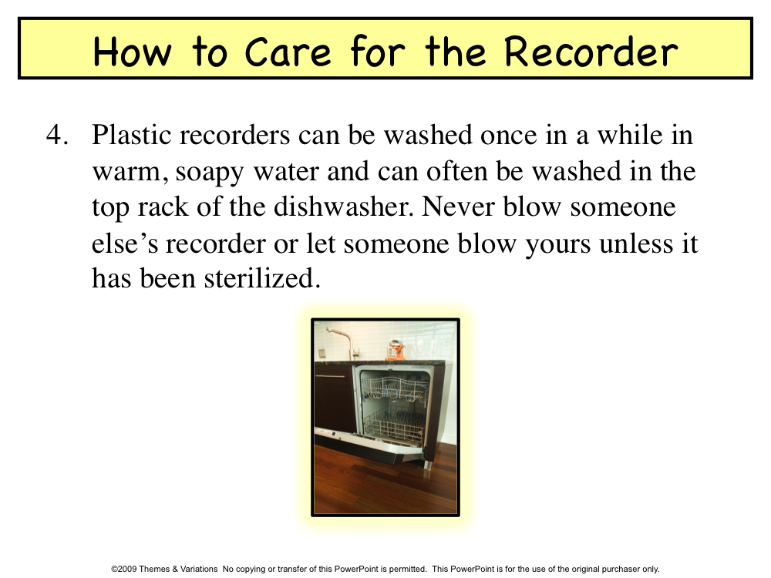
Index

Slide 6
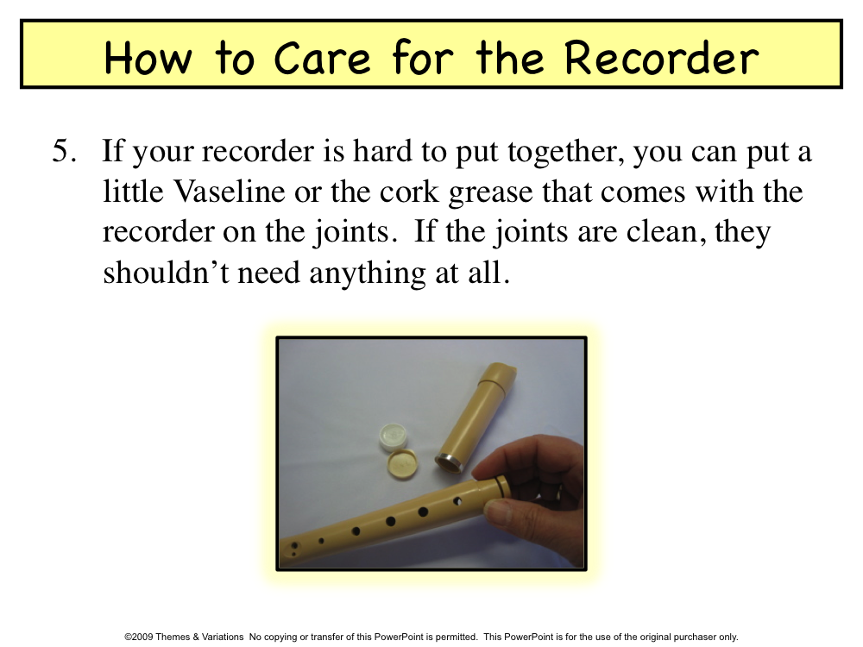
Do this at home!
Index

Slide 7
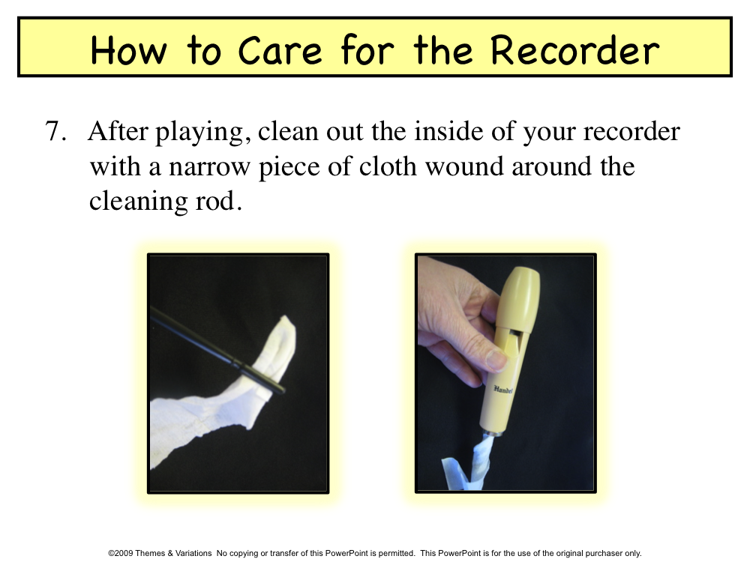
You only need to do this if you practice a lot at home and your recorder is wet with condensation!
Index

Slide 8
Embouchure = how you position your lips and facial muscles. Embouchure and breath control determine your tone quality, intonation and articulation!

Slide 9
Sit tall. Keep arms and fingers curved; thumbs and wrists straight.

Slide 10
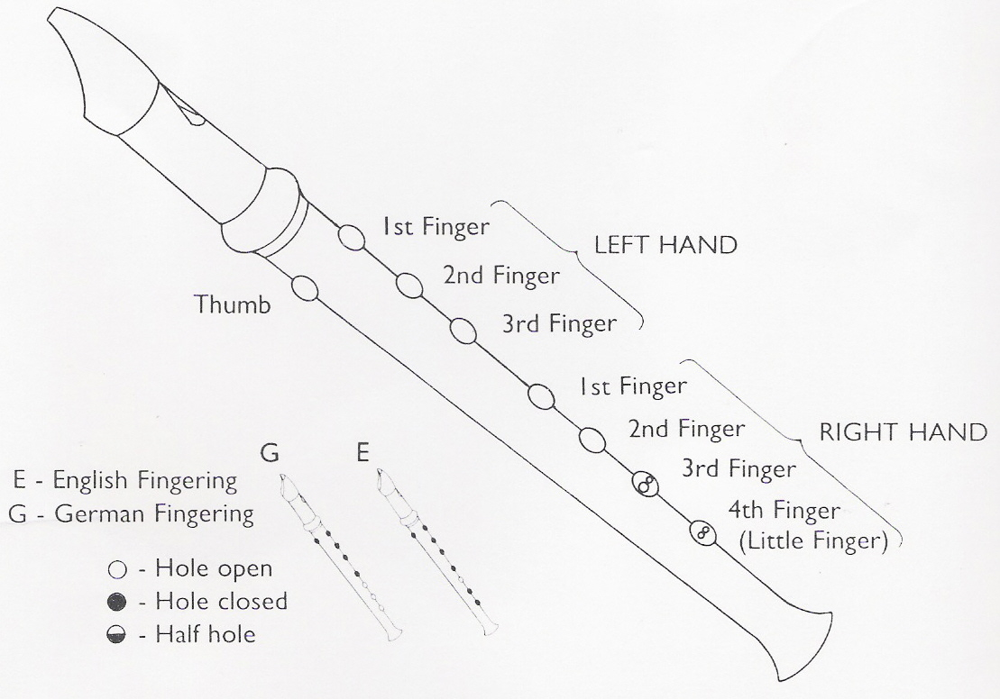
Your right hand can hold on to the bell,
below the holes, without covering the bottom hole

Slide 13
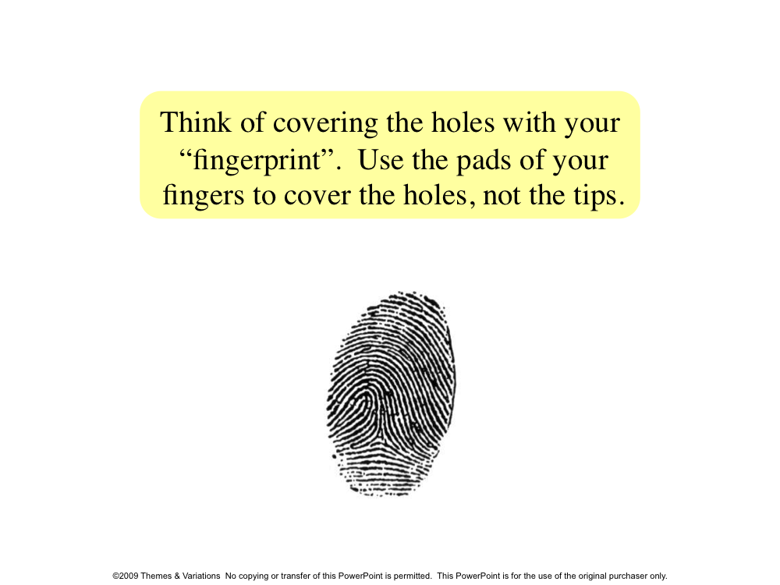

Slide 14

Hot Cross Buns

Slide 15
Mary Had a Little Lamb

Slide 16
Down By The Station

Slide 18
Cobbler, Cobbler

Slide 19

Juba

Slide 20
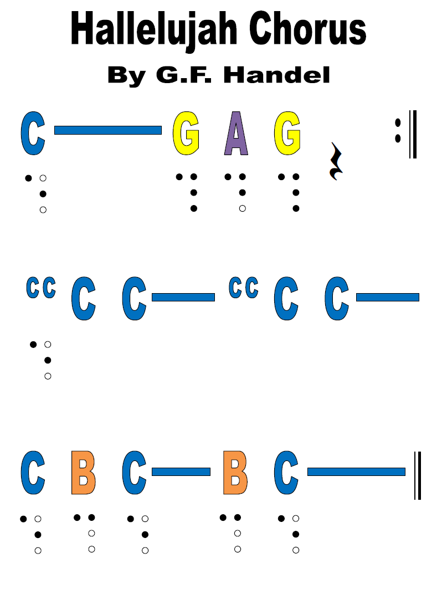


Slide 21
Verses 1 :
8 Beats of an improvised call:
1. Happy days are here again
8 Beats of an all group response: G A A— G A A—
The time is right for makin' friends
2. Let's get together, how 'bout a quarter to ten
Come tomorrow, let's all do it again
3. Boys will be boys, better let them have their toys
Girls will be girls, cute pony tails and curls
4. Must put an end to this stress and strife
I think I want to live the sporting life
Chorus
Verse 2:
1. A rumor has it that it's getting late
Time marches on, just can't wait
2. The clock keeps turning, why hesitate
You silly fool, you can't change your fate
3. Let's cut the rug, a little jive and jitterbug
We want the best, we won't settle for less
4. Don't be a drag, participate
Clams on the half shell and roller-skates, roller-skates
Chorus
Chorus:
A B
Good times,
A A A A B
these are the good times
A A A A B
Leave your cares behind
A A A A B
these are the good times
A B
REST REST REST Good times,
A A A A B
these are the good times
A A A A B
Our new state of mind
A A A A B
these are the good times

