Slide 1
Reading Rhythms
Names and Counting

Slide 2
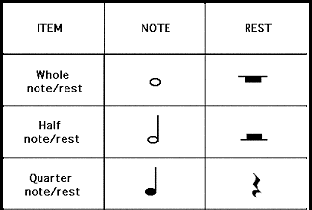
Basic Rhythms for grades 2 and 3
COUNTS/BEATS
1 2 3 4
1 2 2 3 or 3 4
1, 2, 3, or 4
Eighth notes
1, 2, 3, or 4

Slide 3
Rhythms for grades 4 and 5

Slide 4
Count “1 2 3 4”
*If there are eighth notes or dotted quarter notes in the measure, see the green section* *If there are sixteenth notes or dotted eighth notes in the measure, see the purple section*
Count “1 + 2 + 3 + 4 + ”
Count “1e+a 2e+a 3e+a 4e+a”

Slide 5
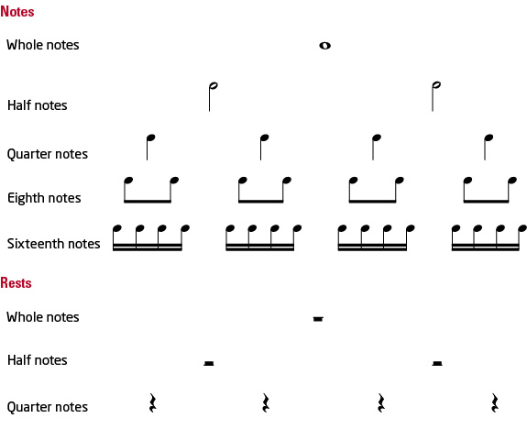
Another way to think about rhythms
Fills up the
whole measure
Looks like a bird’s eye view of a hole in the ground
Think of fractions!
Looks like a cross-section view
of a hole in the ground
rest
Looks like a hat on
top of the line
rests
The beat line is bent and broken, so it doesn’t make 1 beat of sound; its just one beat of silence
rests

